Slide 1

Artificial
Intelligence
IN SCHOOLS

Slide 2


Educators who engage in action research are 25% more likely to report improvements in student engagement and achievement.
Why Action Research
Identify
Reflect
Plan
Observe
Act
Notes:
Today, we’re exploring action research as a powerful driver of meaningful change in our schools. Action research is a structured process where educators identify a problem, plan an intervention, implement it, observe results, and reflect on the findings. Its cyclical nature promotes continuous improvement based on real, classroom-based evidence.
This approach allows us to tackle real-world educational challenges with tailored solutions, enhancing student engagement and achievement. By working together, teachers build a culture of shared responsibility and growth, driving evidence-based change across the school.
In essence, action research is more than a method; it’s a commitment to continuous improvement for our students and school community. Let’s dive into how each step in this process can elevate our practice and impact.

Slide 3

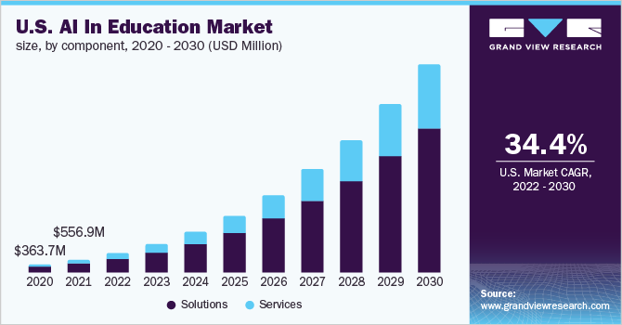

Importance of the Research Proposal:
Responsible AI Usage in Education
Notes:
Khan Academy
CodeHS
NOT REALLY AI
KAHNMIGO
CANVA (images)
ChatGPT (debugging)
Adaptive learning
Today, AI tools are rapidly reshaping how students approach learning, offering new ways to access information and complete assignments. However, this presents a critical challenge: How can we encourage students to use these tools responsibly while preserving core educational values like critical thinking and integrity?
The core problem our research addresses is the unstructured and often unregulated use of AI in educational settings. Without clear guidance, students may lean on AI tools in ways that bypass genuine learning or lead to academic dishonesty. This issue has both immediate impacts on student learning and longer-term implications for their development as responsible digital citizens.
Studies underscore the urgency of this topic. For instance, a recent survey found that over 60% of high school students have used AI to assist with homework, but only a fraction reported that they received guidance from teachers on how to use these tools effectively and ethically. This gap highlights a significant opportunity—and responsibility—for educators to lead the way in establishing responsible AI practices (Grandview, 2022).
In this proposal, we’ll explore actionable strategies that educators can implement to teach responsible AI usage, emphasizing character development and critical thinking. By addressing this issue, we not only improve educational outcomes but also prepare students to navigate a technology-driven world responsibly.

Slide 4
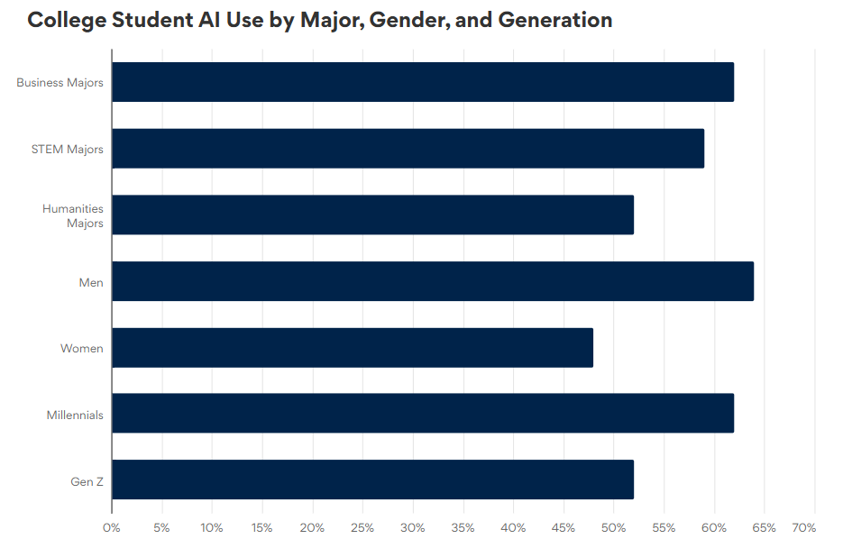
Key Data:
Notes:
I would first like to highlight the significant percentage of students are already using AI tools, primarily for tasks like research and writing assistance. With over %50 of students in all demographics reporting to be using AI, this data reinforces the need for structured guidance on how to use these tools responsibly (Nam, 2023).

Slide 5
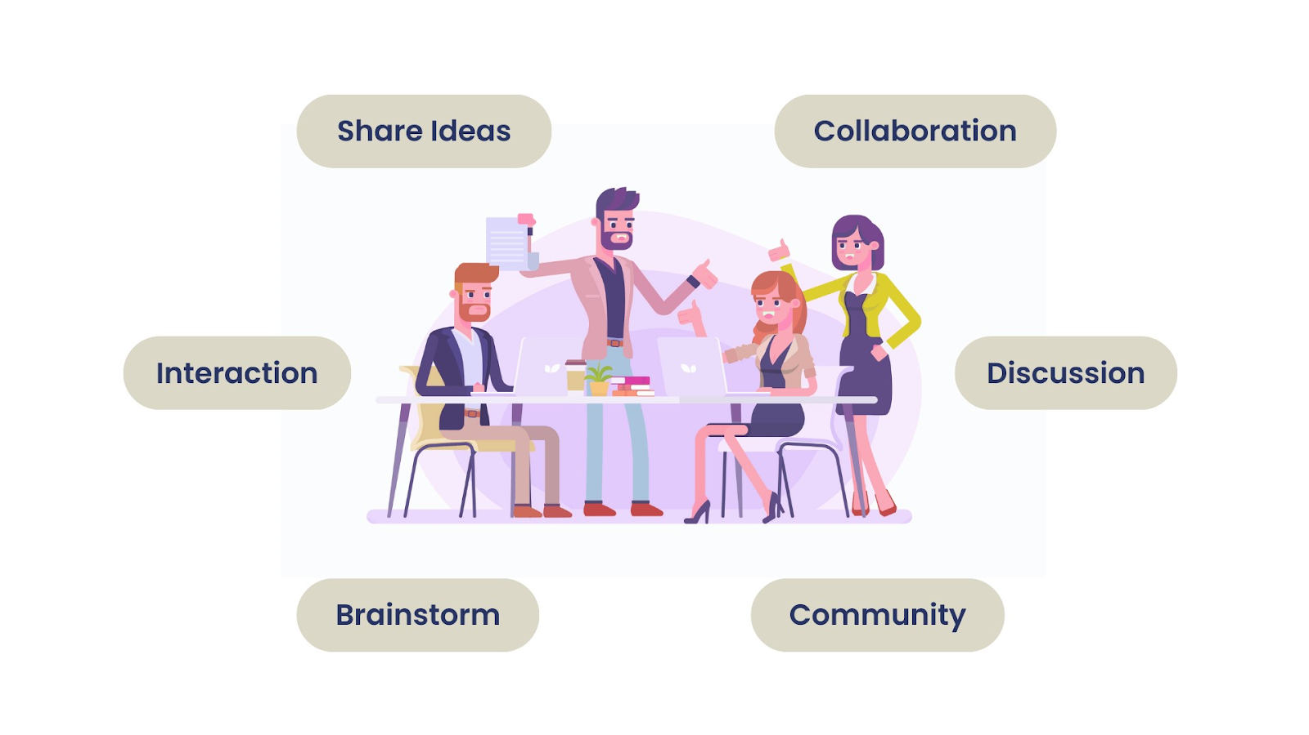
Collaborative Inquiry
Notes:
This slide demonstrates the impact of collaborative inquiry on educational outcomes. Schools where teachers engage in collaborative problem-solving report higher levels of student engagement and improved critical thinking skills. This aligns well with our proposal’s focus on using collaborative inquiry to develop AI usage guidelines, showing that a community-based approach can lead to more effective and lasting results.
Combined with the data regarding AI use from students, there are significant potential benefits of a collaborative inquiry approach for addressing the challenges that arise from this trend.

Slide 6

Proposed Action Plan Overview
Problem
Research Question
Intervention Strategy
Goal
Target Population
Action Steps
Notes:
Problem: The need to guide responsible AI usage in the classroom. With the growing prevalence of AI tools, we need to ensure they’re used in ways that support learning and integrity.
Research question—“How can we guide students to use AI tools responsibly while enhancing critical thinking?”
Training teachers on best practices for AI and fostering a collaborative inquiry approach.
The goal here is to cultivate responsible AI habits that enhance learning rather than detract from it.
The target population includes high school students, who are already actively using AI, and their teachers, who play a key role in modeling ethical practices.
Finally, our action steps include teacher training, classroom guidelines, and student-led workshops. Each step builds on collaborative inquiry principles and provides practical pathways for effective change.

Slide 7



Persons Responsible, Resources, and Timeline
Persons Responsible
Lead Teacher
IT Specialist
School Administrator
Teacher Participants
Student Representatives
Resources Needed
AI Tool Training Materials
Professional Development Funding
Workshop Space
Digital Access Tools
Timeline
Phase 1: Month 1
Teacher Training
Phase 2: Month 2
Guideline Development
Phase 3: Month 3
Student Workshops
Notes:
In this plan, each person’s role is clearly defined. The Lead Teacher will oversee the project, coordinate with the IT Specialist for technical support, and work closely with the School Administrator to ensure alignment with school policies.
Our resources include AI tool training materials, professional development funding, and a dedicated workshop space. These are critical to effectively equipping teachers and engaging students in responsible AI use.
The timeline is broken down into three phases over three months, keeping the project feasible. First, we’ll focus on teacher training, followed by guideline development, and finally, student-led workshops. Each phase emphasizes teamwork and clear communication to ensure smooth transitions and sustained progress.

Slide 8



Benefits to Stakeholders
Community
Educators
Students
Notes:
Let’s explore the benefits that this action plan brings to all stakeholders involved.
INDEPENDENT LEARNERS
Starting with educators: this initiative equips teachers with essential training and tools for integrating AI responsibly. Professional development in AI ethics and technology helps teachers not only adapt but thrive as they incorporate these tools into their classrooms.
For students, the benefits are significant. They will learn how to use AI tools as aids for problem-solving and learning, not just shortcuts for completing assignments. This promotes critical thinking and responsible tech habits—skills that will serve them well beyond the classroom.
The entire school community stands to gain from this action plan. By fostering a culture of responsible AI use, we reinforce academic integrity and encourage collaborative inquiry among teachers and students. Studies have shown that schools with strong, collaborative environments tend to see improved educational outcomes and student engagement.
These predictions are backed by recent literature. Research indicates that when schools adopt technology responsibly and inclusively, student achievement and teacher satisfaction improve. A culture that integrates AI tools thoughtfully benefits everyone involved by creating a future-ready, ethical learning environment.

Slide 9



Next Steps
Immediate Actions
Schedule teacher training
Develop guidelines
Establish communication channels
Long-Term Goals
3-month review
Adjust Guidelines
Expand training
Notes:
To ensure the success of this action plan, let’s outline the next steps. Immediately, we need to schedule comprehensive teacher training sessions that focus on responsible AI use. This step sets the foundation for our entire strategy by equipping educators with the knowledge and tools they need.
Simultaneously, we’ll develop the first draft of classroom guidelines for AI use, created collaboratively with teacher input. Establishing clear communication channels among educators, the IT team, and the school administration is also critical for seamless coordination.
Looking at our long-term goals, after three months, we’ll evaluate the effectiveness of these initial measures. This assessment will include collecting teacher and student feedback, reviewing classroom outcomes, and identifying any necessary adjustments to the guidelines.
Our final goal is to expand this initiative to more staff members, including additional subject teachers and student representatives, creating a school-wide culture of responsible AI use and collaborative inquiry. This approach ensures that the changes we implement are sustainable and continue to support our educational goals in the long run.

Slide 10
References:
Author Unknown(2022). AI In Education Market Size, Share & Trends Analysis Report By Component (Solutions, Services), By Deployment, By Technology, By Application, By End-use, By Region, And Segment Forecasts, 2022 - 2030. Grandview Research.
https://www.grandviewresearch.com/industry-analysis/artificial-intelligence-ai-education-market-report
Creswell, J.W. and Poth, C.N. (2018). Qualitative Inquiry and Research Design Choosing among Five Approaches. 4th Edition, SAGE Publications, Inc.
https://pmc.ncbi.nlm.nih.gov/articles/PMC8455229/
Nam, J. (2023). 56% of College Students Have Used AI on Assignments or Exams. Best College.
https://www.bestcolleges.com/research/most-college-students-have-used-ai-survey/
Worku, M., Getahun, D., Aganofir, A. (2022). Improving Teachers’ Engagement in Action Research: A Baseline Study in Primary Schools of Bahir Dar City. Systemic Practice and Action Research. https://papers.ssrn.com/sol3/papers.cfm?abstract_id=4900253
Wyatt-Smith, C. & Kimber, M. (2024). Teaching, Learning and Assessing in the AI-era: Considering the Framework for Generative AI in Schools. Australian Educational Leader, 2024. https://research.ebsco.com/c/36ffkw/viewer/pdf/v6sljjt2b5

